Slide 1
Verifikasi kemiripan wajah menggunakan deep learning dengan arsitektur Jaringan siamese
Hairul Imam
1310520075

Slide 2
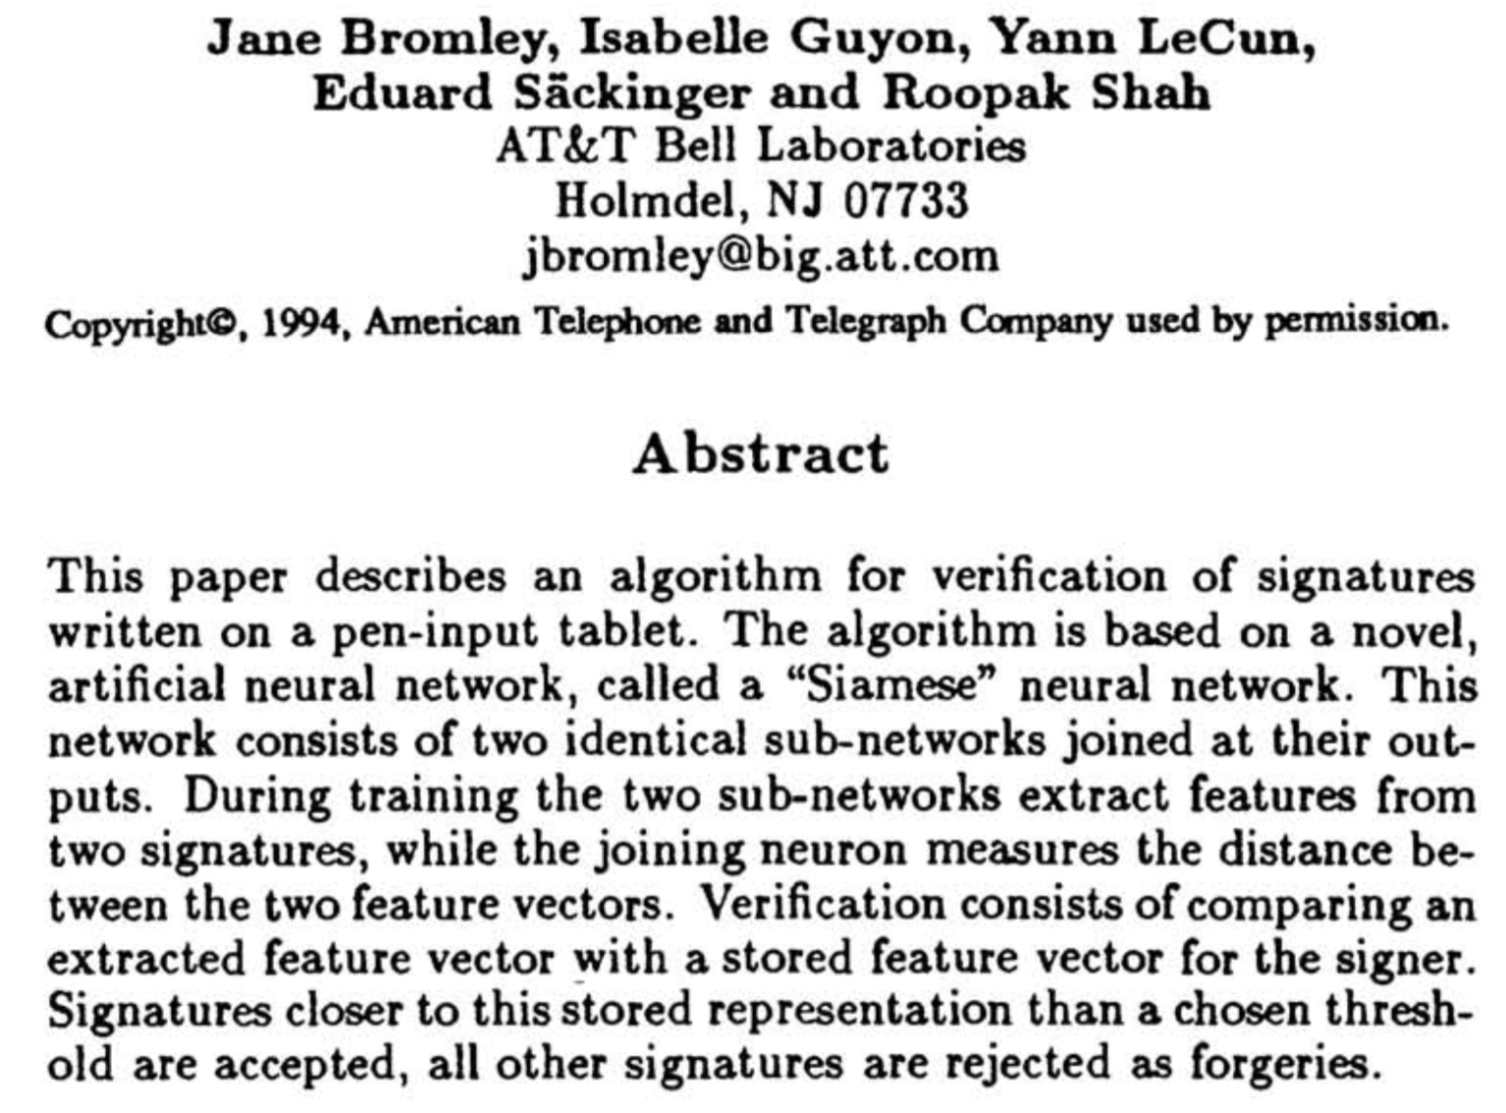
What is Siamese
Notes:
The Idea of comparing two or three network outputs.

Slide 3
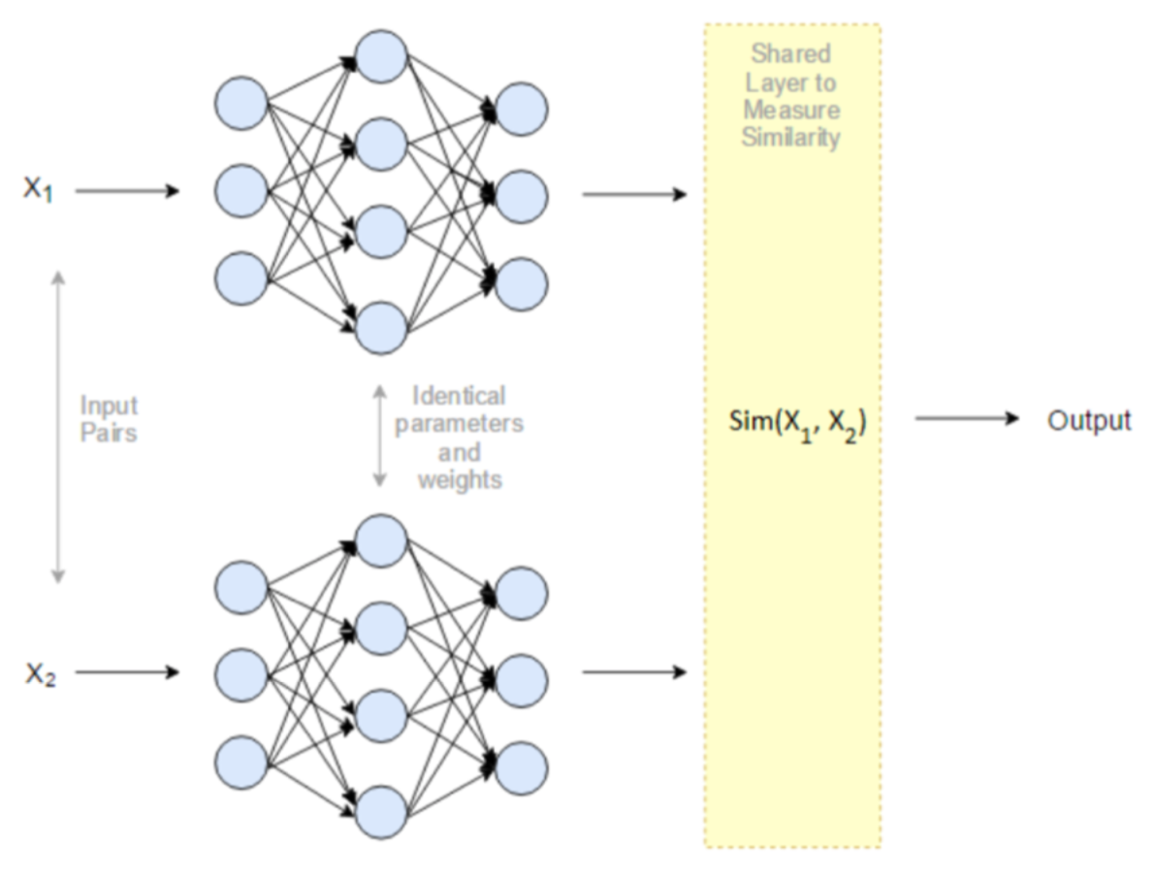

Slide 4
Body Of The Siamese

Slide 5
ResNet-50

Slide 6
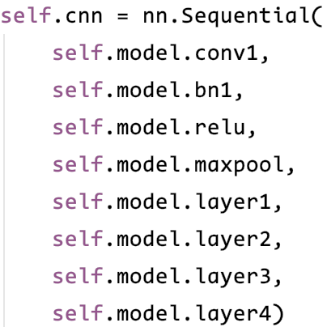
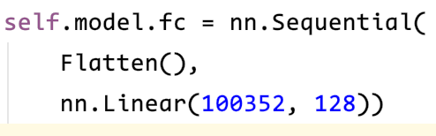
Feature Extraction
Feature Mapping/Embedding

Slide 7
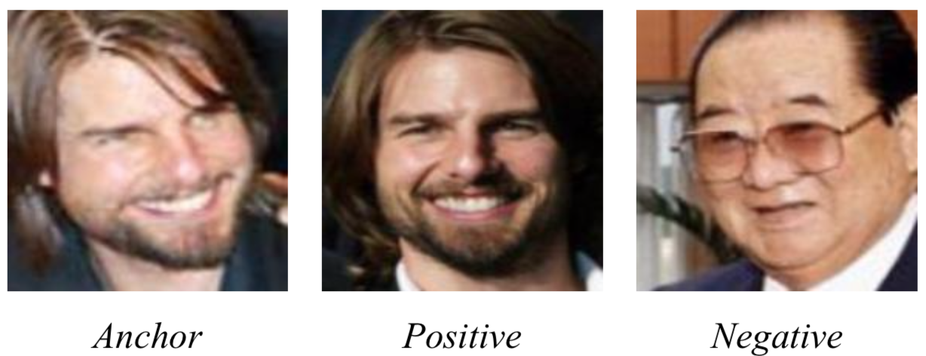
Trained Using Triplet Loss

Slide 8
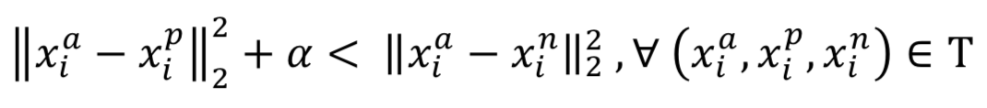
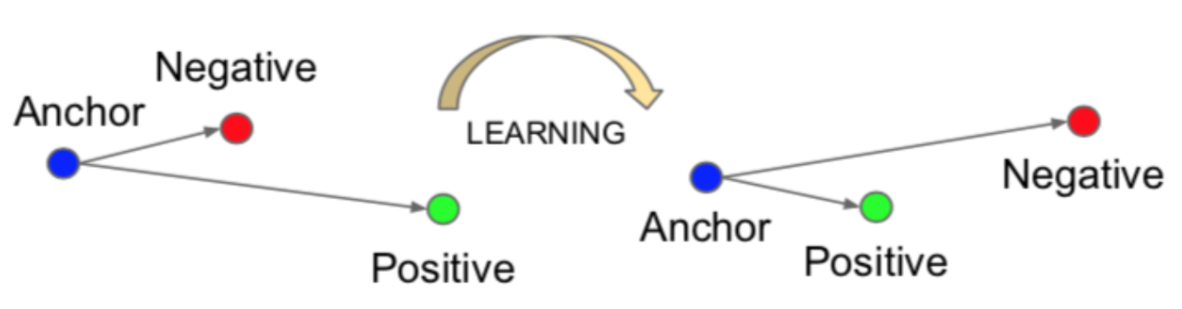
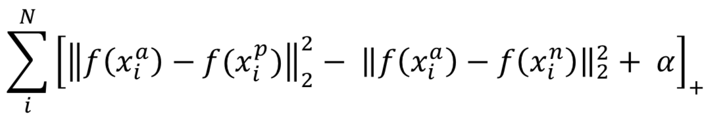
Triplet Loss Objective
Minimize

Slide 9
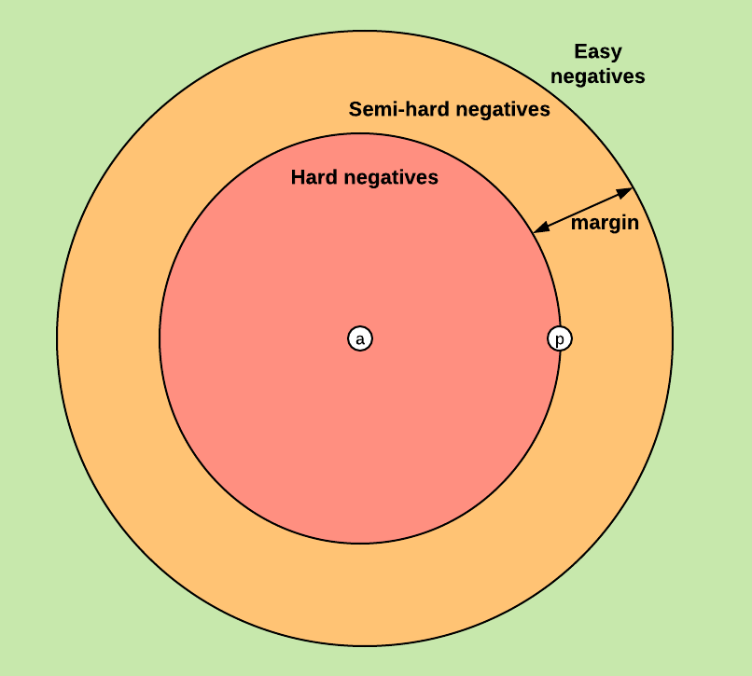
Triplet Selection

Slide 10
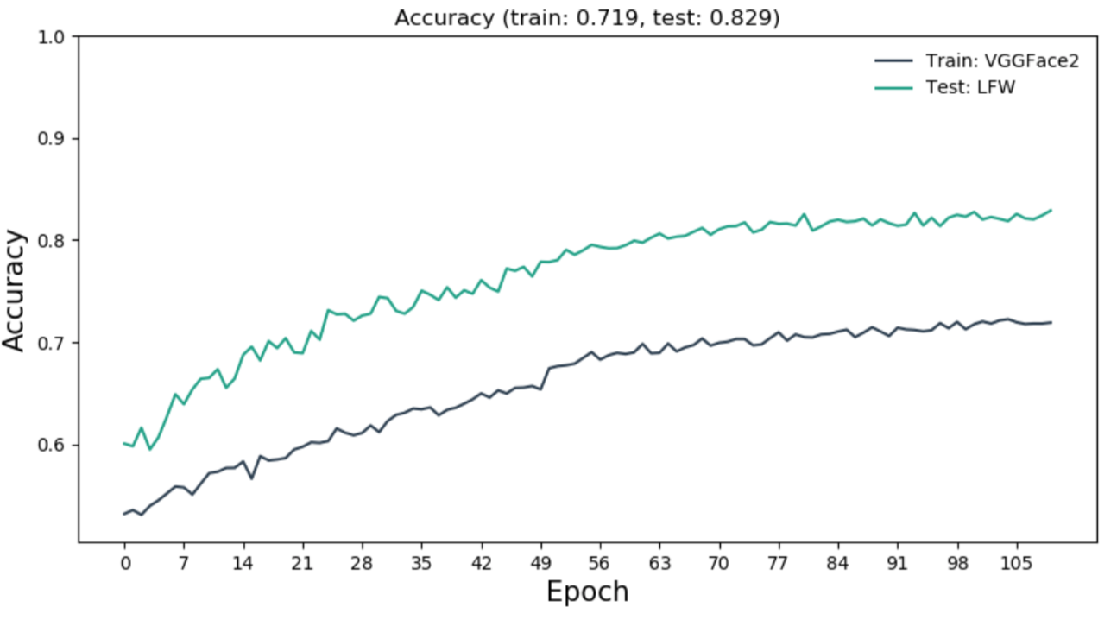
Train Embedding Layer

Slide 11
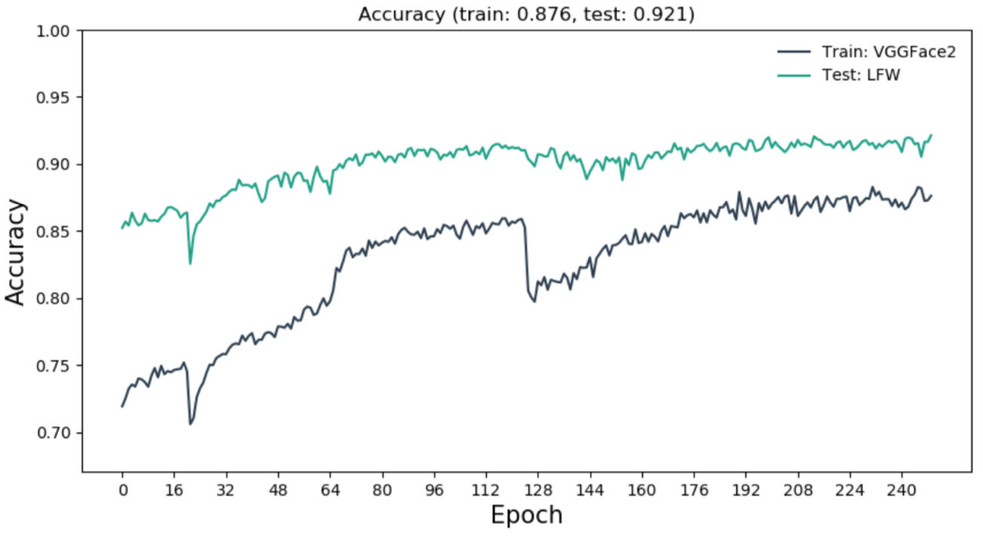
Retrain CNN Layers

Slide 12
